Slide 1

K means Clustering
ML Kaggle SMP
Mentors:
-Anupama
-Rishik
-Shipra
-Surabhi

Slide 2
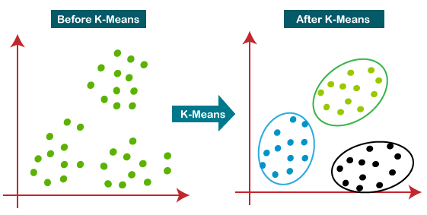
What is K means?
A method which aims to partition n observations into k clusters (k<n) in which each observation belongs to cluster with nearest mean

Slide 3
Why K means?
Fast, Robust
It gives best results when the datasets have the data well separated from each other
Once K value is known, it is easy to implement
It can easily adapt to new datasets because its unsupervised :)

Slide 4
Drawbacks of K means
It is sensitive to outliers and noise which reduces the accuracy :(
We cant use it when we donot have information on how many clusters to split the dataset into.
Different initial partitions can result in different final partitions

Slide 5

Implementation
We have to make an algorithm which partition n data observations into k disjoint subsets so that the following equation is minimised
Represents vector of nth data observation, and Mj is the geometric centroid of the data
observations which are in the jth cluster

Slide 6
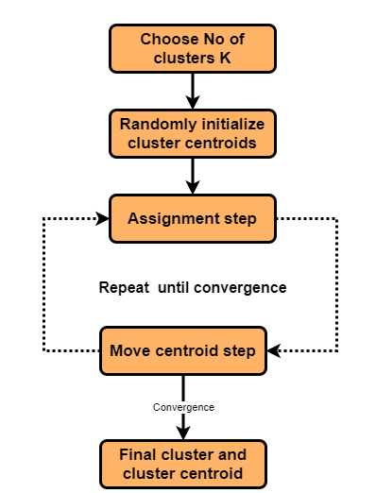
Algo !!
Randomly initialise k data points as centroids of k clusters
Now, assign the data points to their closest centroids
Now, update the centroid to the geometric centric of these points
Repeat 2,3 till no points change their cluster..
This is when the convergence occurs

Slide 7
Properties of this K means
Convergence is guaranteed in finite no. of steps
Running time per iteration:
Assigning all data points to their respective closest centroids takes O(KN) time
Changing the centroids of clusters to their geometric centroids takes O(N) time

Slide 8
Let's look at some code now!

